Slide 1
Distributed Systems and Fallacies
Pravin Y Pawar

Slide 2
Distributed Systems
The hurdles todays developers face when they are building applications for the first time are
Needs to deal with services that are not on the same machine
Need to deal with patterns that consider network between machines
Without knowing they have entered into world of distributed systems!
Distributed system is system in which individual computers are connected through a network and appear as single computer to the outside world.
Provides power across machines to accomplish scalability, reliability and economics
For example,
Most cloud providers are using cheaper commodity hardware for solving common problems of high availability and reliability through software

Slide 3
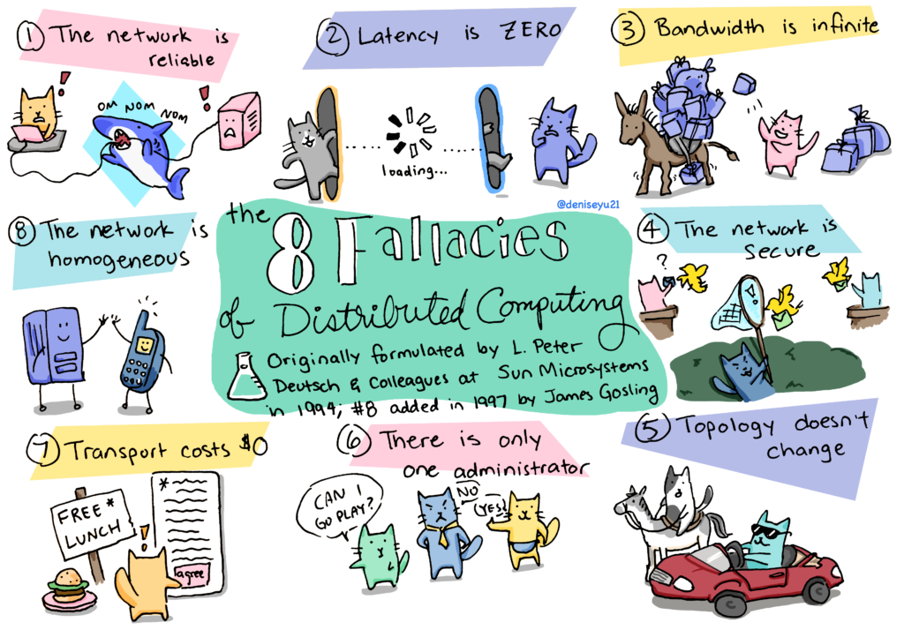
Fallacies of Distributed System
Couple of incorrect or unfounded assumptions
Peter Deutsch, in 1994, identified them, still have validity today
source

Slide 4
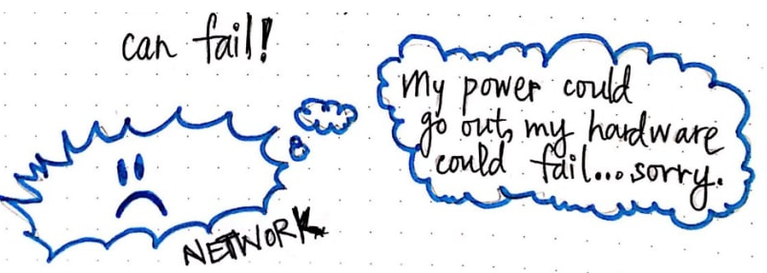
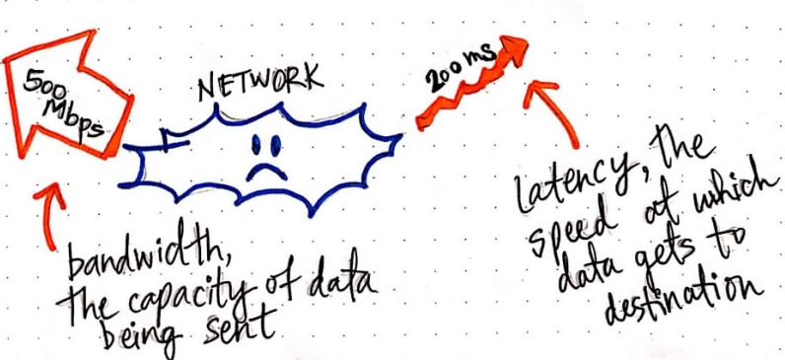
Fallacies
Fallacy #1: The network is reliable
An easy way to set up for failure
A few possible problems are:
power failure
old network equipment
network congestion
weak wireless signal
software network stack issues
rodents
DDOS attacks… etc.
Fallacy #2: Latency is zero
Latency is the time it takes between a request and the start of actual response data
Latency within development platforms networks can be as low as one millisecond
In production, when traffic is going over the internet, the story is very different
At this phase, latency is not a constant rate but changes very often.

Slide 5
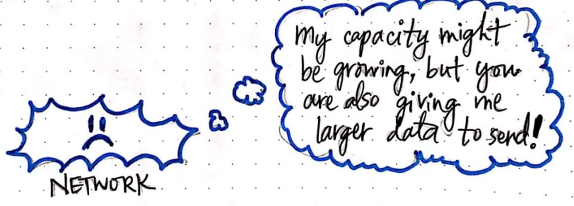
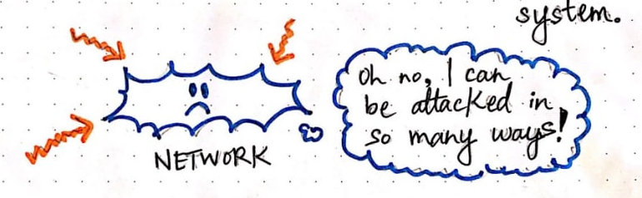
Fallacies(2)
Fallacy #3: Bandwidth is infinite
Bandwidth is the capacity of a network to transfer data
Higher bandwidth means more information can flow through the network
Even though network bandwidth capacity has been improving
at the same time we tend to increase the amount of information we want to transfer
Fallacy #4: The network is secure
The only completely secure system is one that is not connected to any network
Keeping the network secure is a complex task and is a full-time job for many professionals
There is a wide variety of both passive and active network attacks that can render network traffic unsafe from malicious users

Slide 6

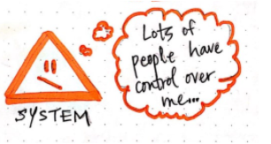
Fallacies(3)
Fallacy #5: Topology doesn’t change
A network topology is the arrangement of the various network elements
The network landscape in a modern computing environment is always evolving
For new developers, it is easy to fall into the trap of assuming that the operating environment does not change
Software that works in the dev and test environment fails when deployed to production or cloud scenarios
Fallacy #6: There is one administrator
For small systems this might not be a problem, but once you deploy to an enterprise-wide or Internet scenario
multiple networks are being touched
one can be sure they are managed by different people, different security policies, and requirements

Slide 7
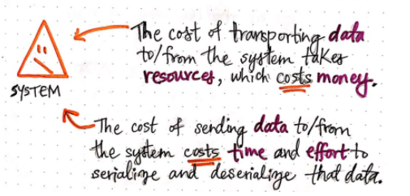
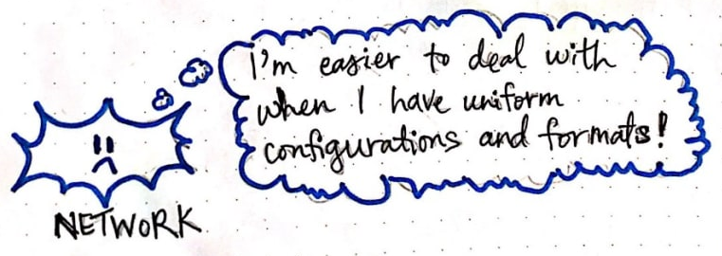
Fallacies(4)
Fallacy #7: Transport cost is zero
Need to do with the overhead of serializing data into the network
Other has to do with the costs of the networking infrastructure
Both of these are realities that cannot be avoided
Fallacy #8: The network is homogeneous
A homogeneous network is one where the elements within the network are using a uniform set of configuration and protocols
For very small networks this might be the case
For large distributed systems such as web applications, one will not be able to predict
the devices that will connect
the protocols used to connect
the operating systems, browsers, etc

Slide 8
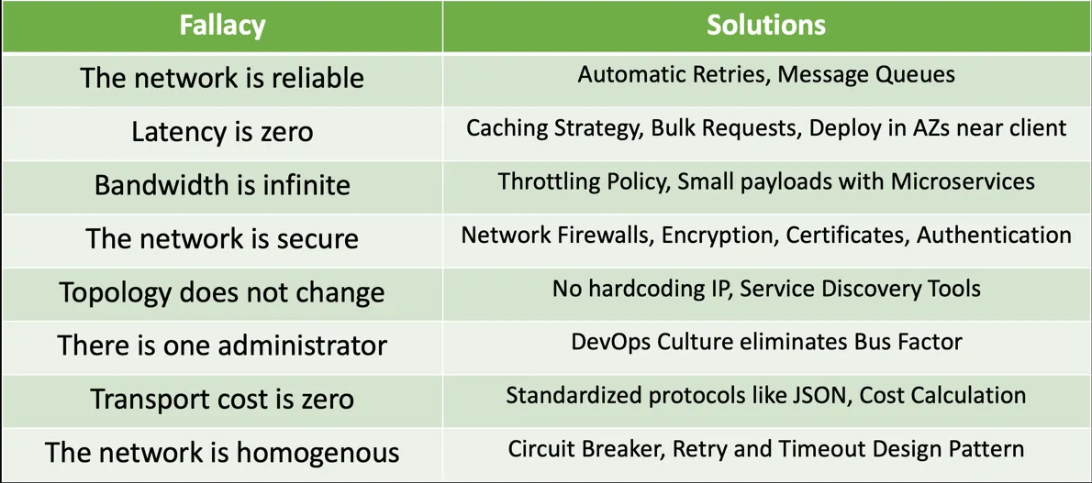
Solutions

Slide 9
Thank You!
References :
Fallacies of distributed Systems
Images
In our next session:

